Slide 1


Clock
Experiment 3
Raphael S. Nano
CPE160P / B1
Computer Engineering Department
School of Electrical, Electronics, and Computer Engineering

Slide 2
Introduction: Clock
It is a device used to measure time
May be analog or digital
It performs a regular movement of intervals determined by seconds, minutes, and hours
It plays an integral role in being consistent in human’s reality

Slide 3
Objectives
To be able to demonstrate how a real clock works.
To be able to apply embedded systems in displaying hours and minutes using Seven-segment display, and switches.
To be able to apply what were learned in Microprocessors and Logic Circuits and Switching Theory.
To be able to apply embedded systems in a simple handshaking using Arduino Kit.

Slide 4
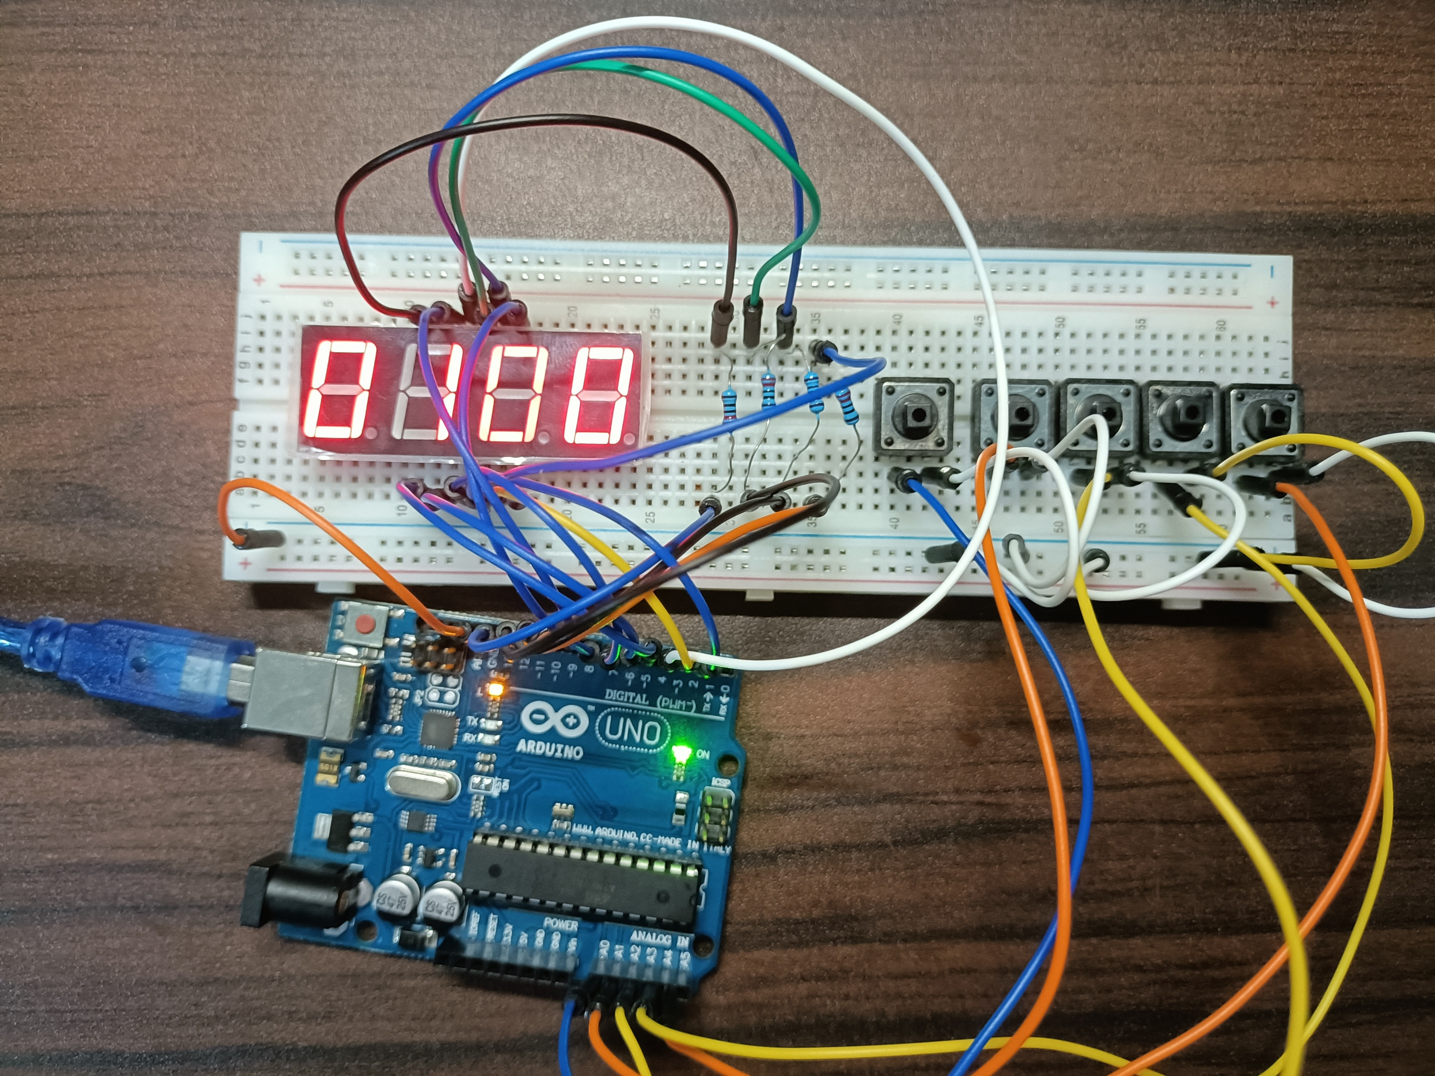
Materials
Arduino Kit
Arduino Uno
1 4-Digit seven segment display
4 resistors
5 switch buttons

Slide 5
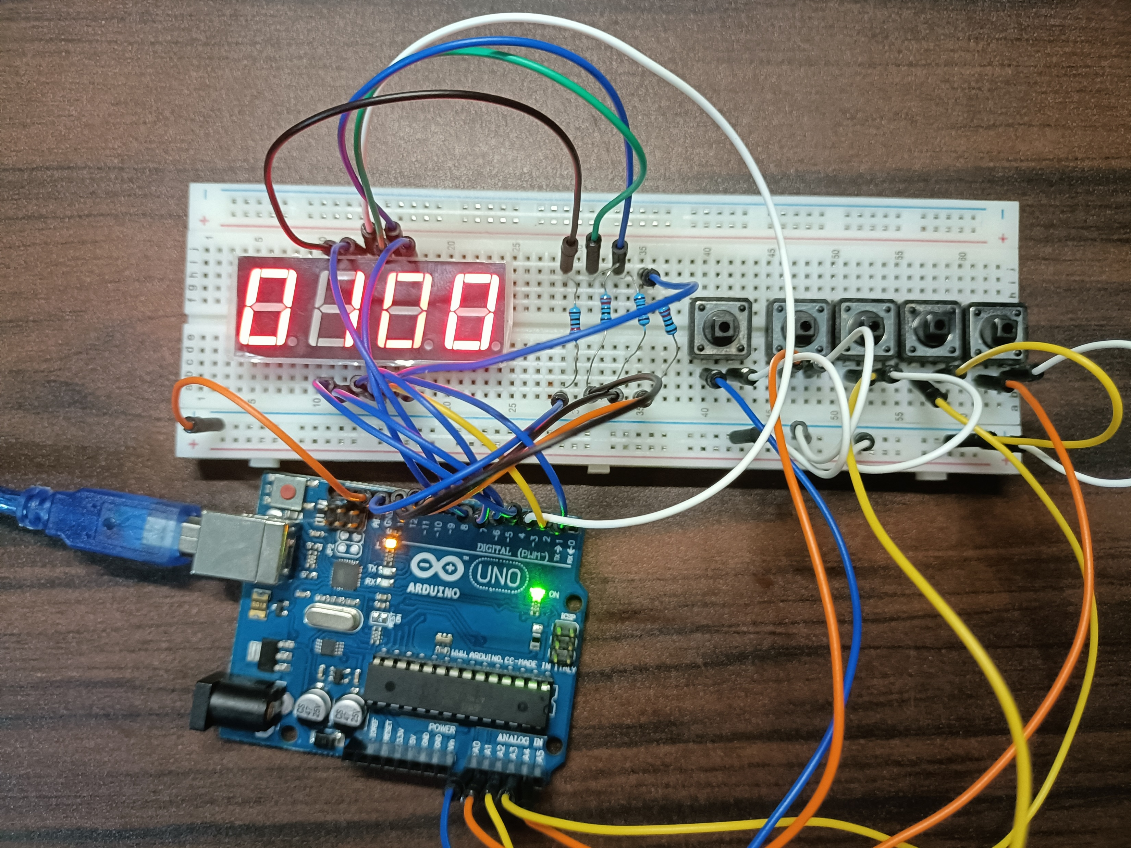
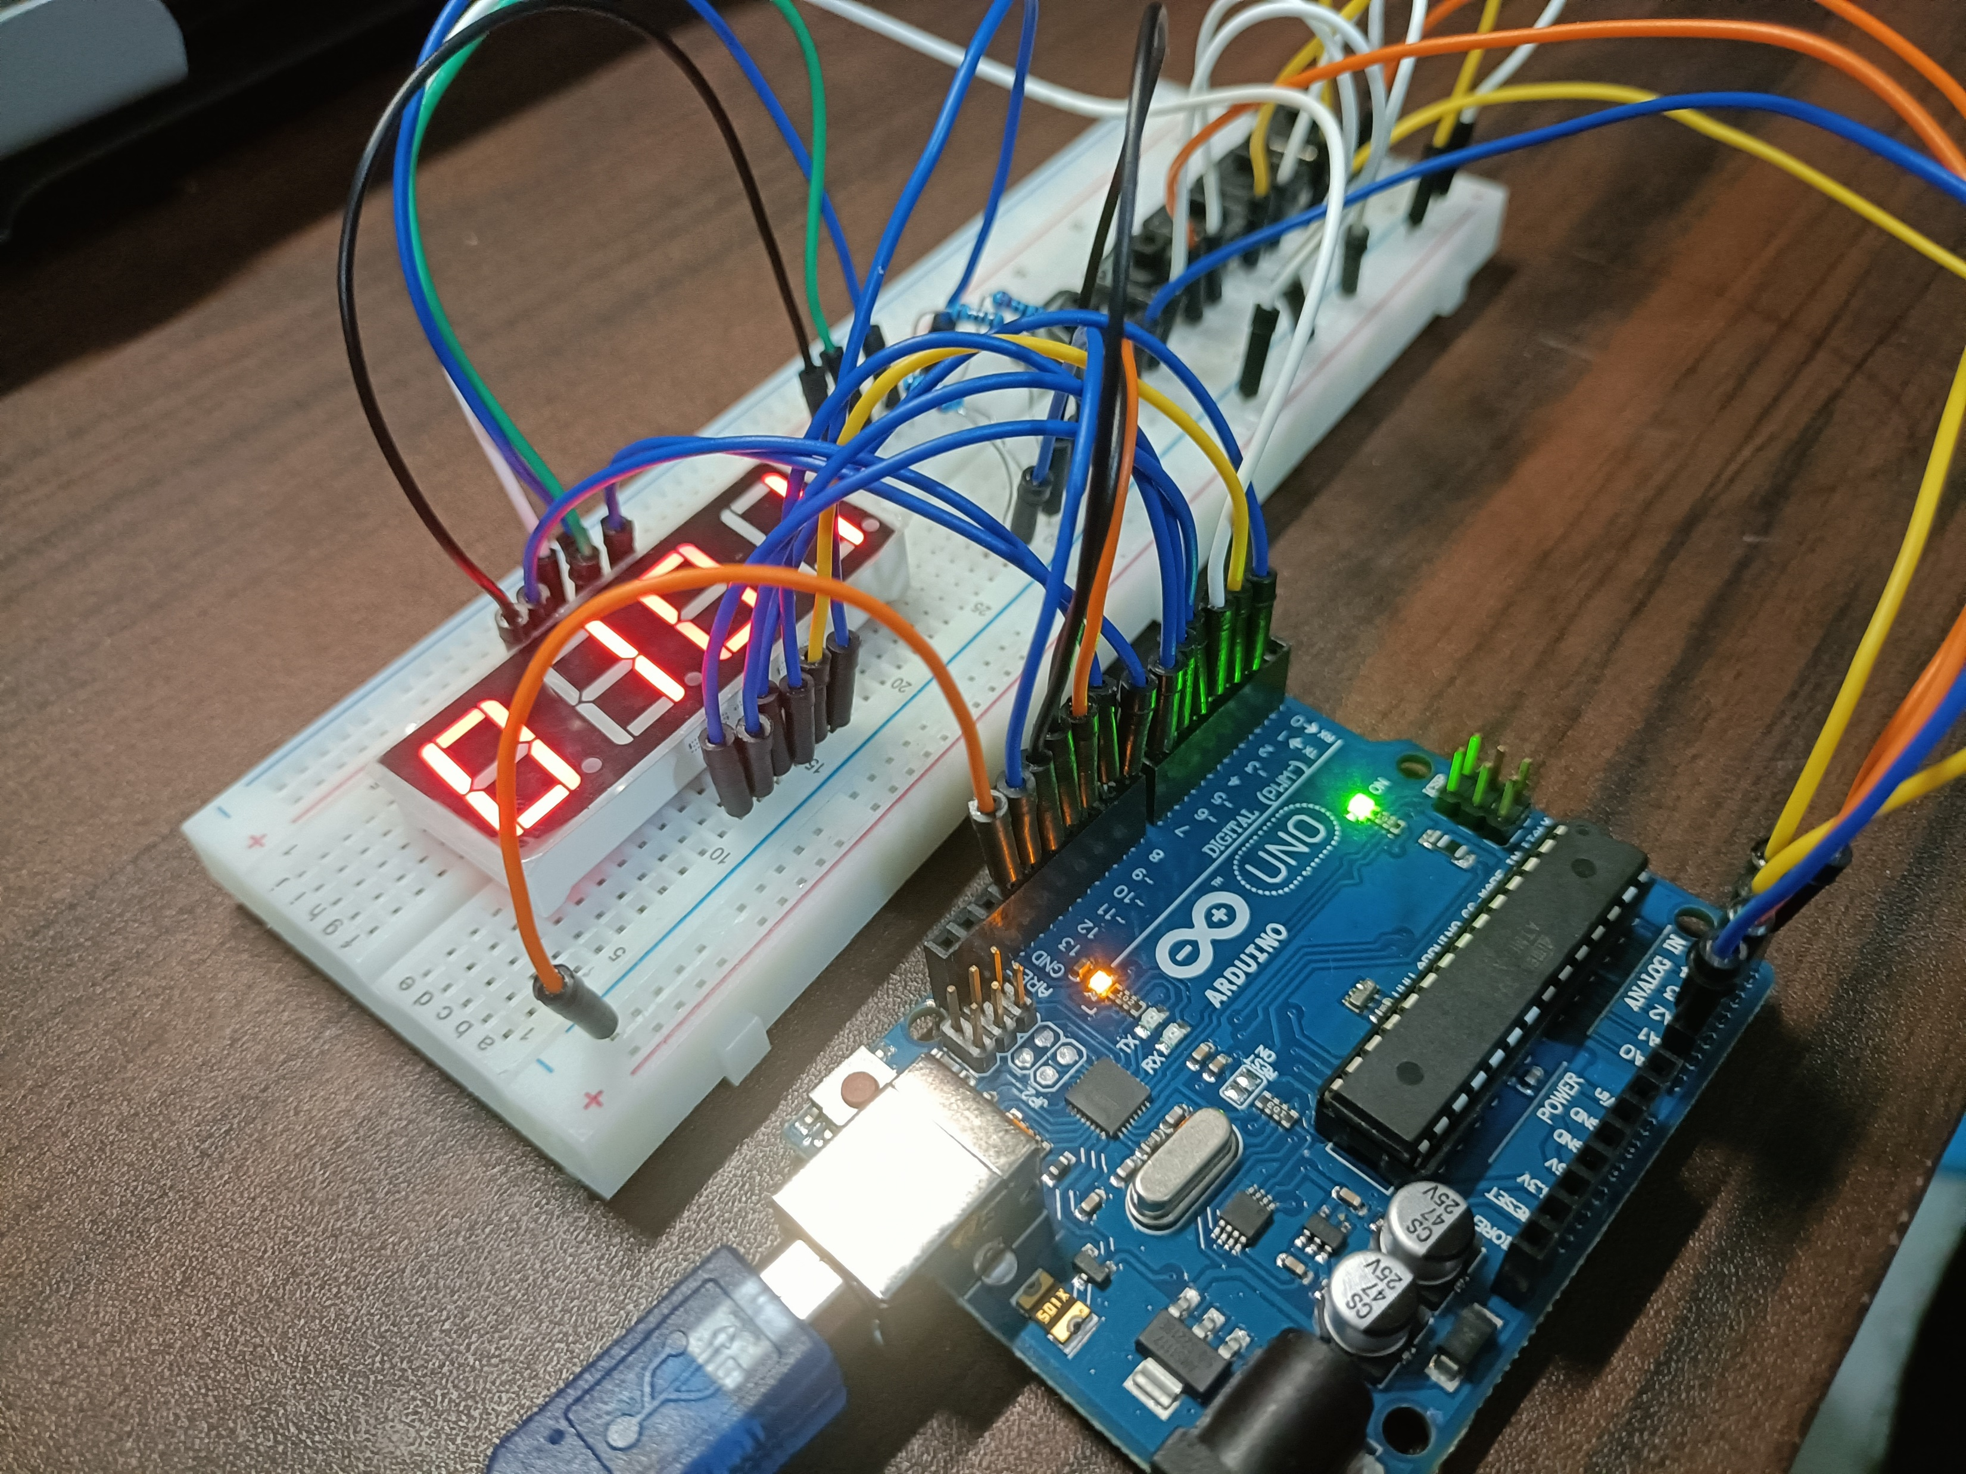
Discussion: Clock System
There are three parts: continuous ticking, increment, and decrement
The output should have a timing of exactly 60000 milliseconds per tick
External library SevSeg.h was utilized
numarrgen() stores possible time combinations
millis() function was used in ensuring the timing

Slide 6
Discussion: Incrementing and Decrementing
The fifth button enables the buttons for adjustment
First button increments hours
Second button increments minutes
Third button decrements hours
Fourth button decrements minutes
Code uses multiple if-else statements in verifying the pressed button

Slide 7
Conclusion
A real clock was recreated using materials from the Arduino kit
The 4-digit seven-segment display and switch buttons were utilized
Configuration of the seven-segment display, delays, and switches applied learnings from Microprocessors and Logic Circuits and Switching Theory
Clock was produced effectively

